Slide 1



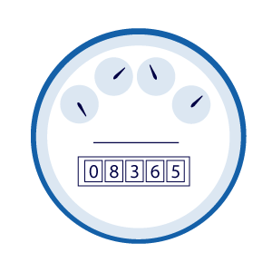



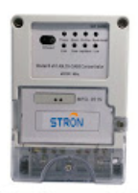



XYZ Electric Co Data Architecture
Stream Analytics
Hourly Electric Meter Data (residential)
Azure Data Lake Storage Gen2
Synapse
Integrate
Streaming Data
Data Pipelines
Data Concentrator
Pre-aggregated Data
Machine Learning
Web End-Points

